Slide 1
Sql Queries Project

Slide 2
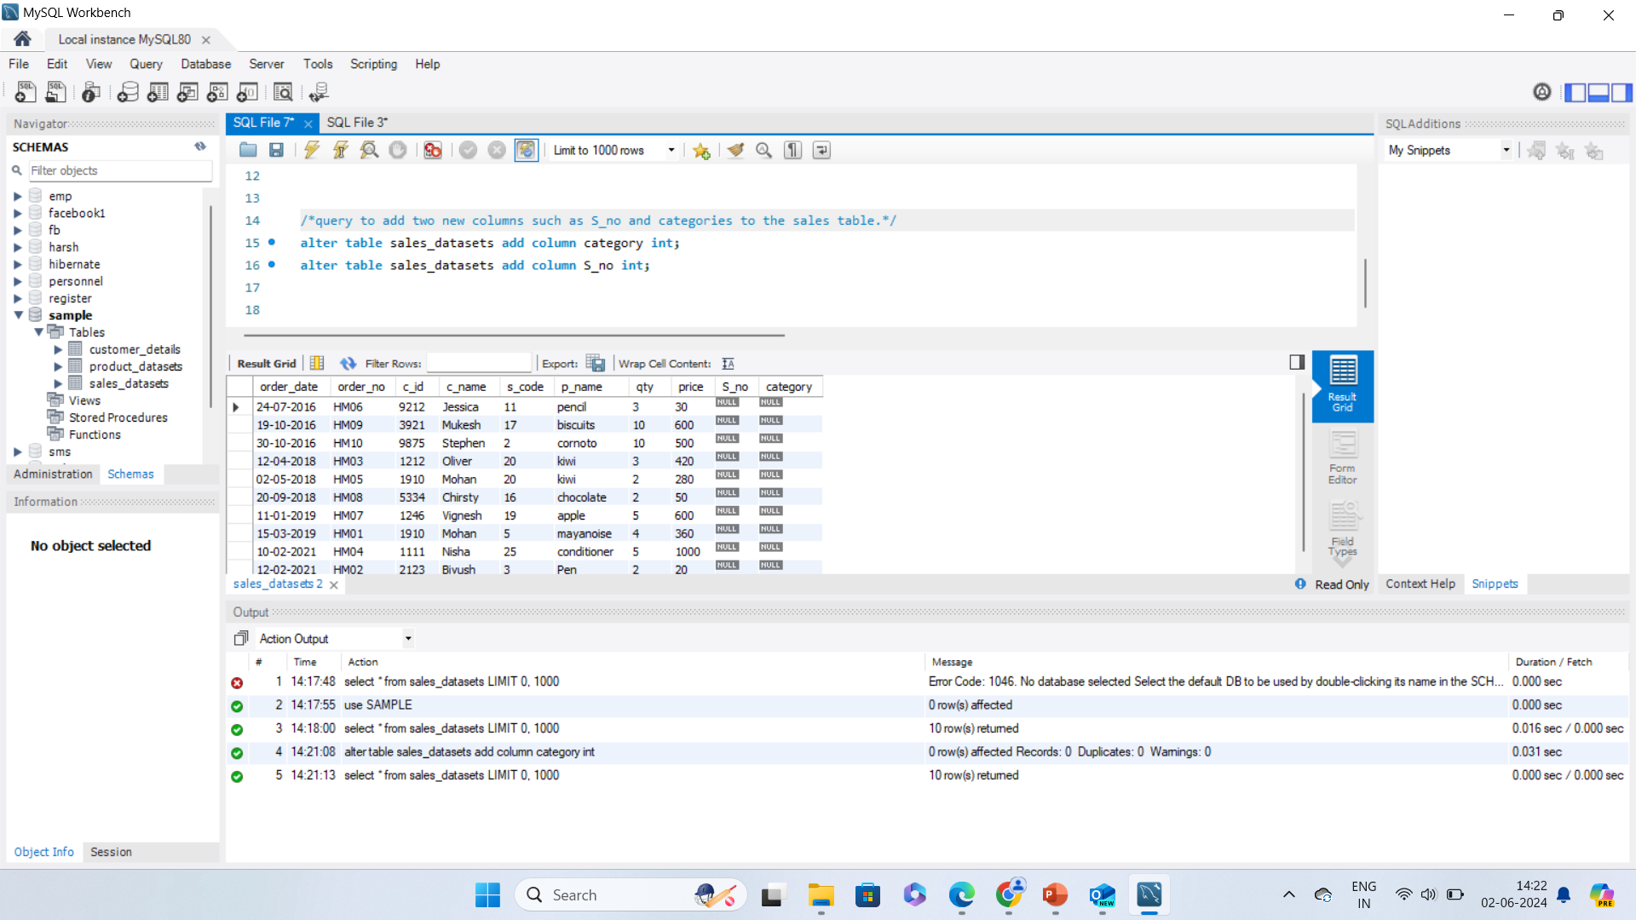
Write a query to add two new columns such as S_no and categories to the sales table.

Slide 3
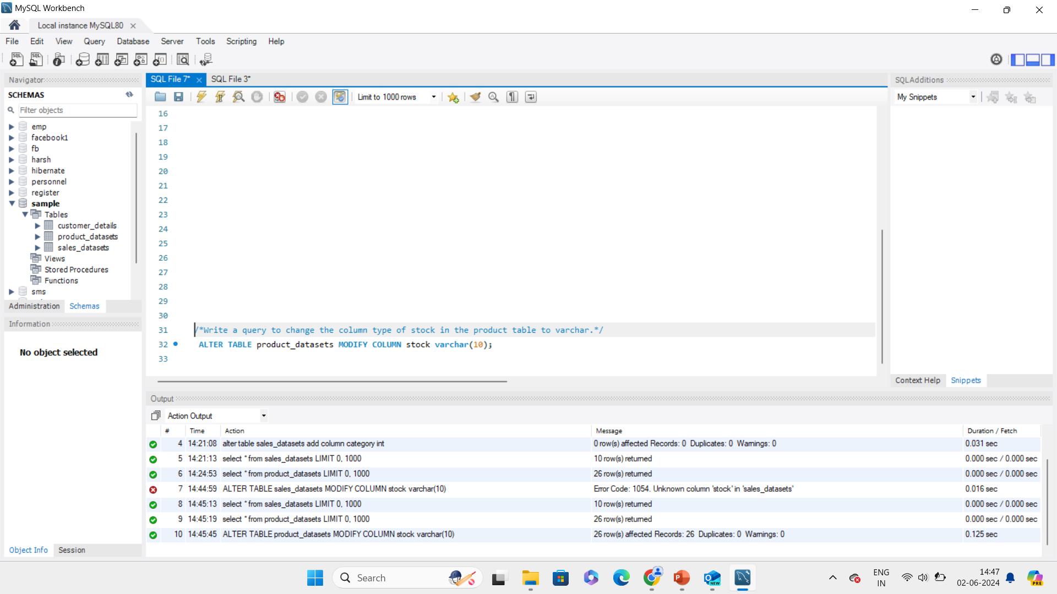
Write a query to change the column type of stock in the product table to varchar.

Slide 4
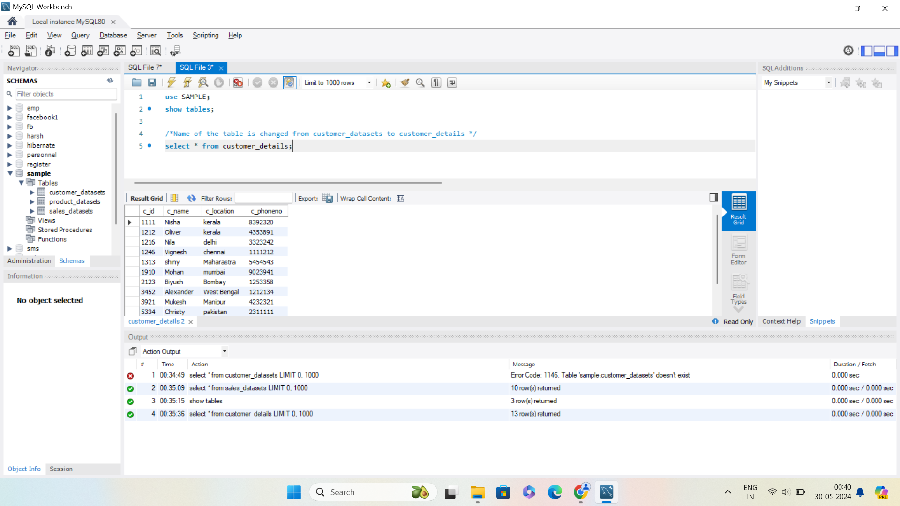
Write a query to change the table name from customer-to-cu stomer details.

Slide 5
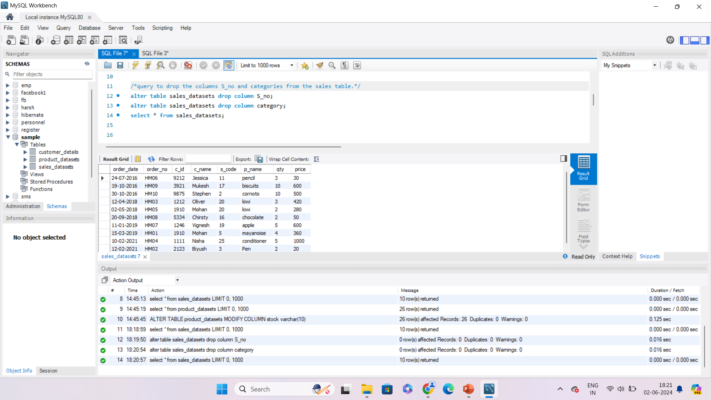
Write a query to drop the columns S_no and categories from the sales table.

Slide 6
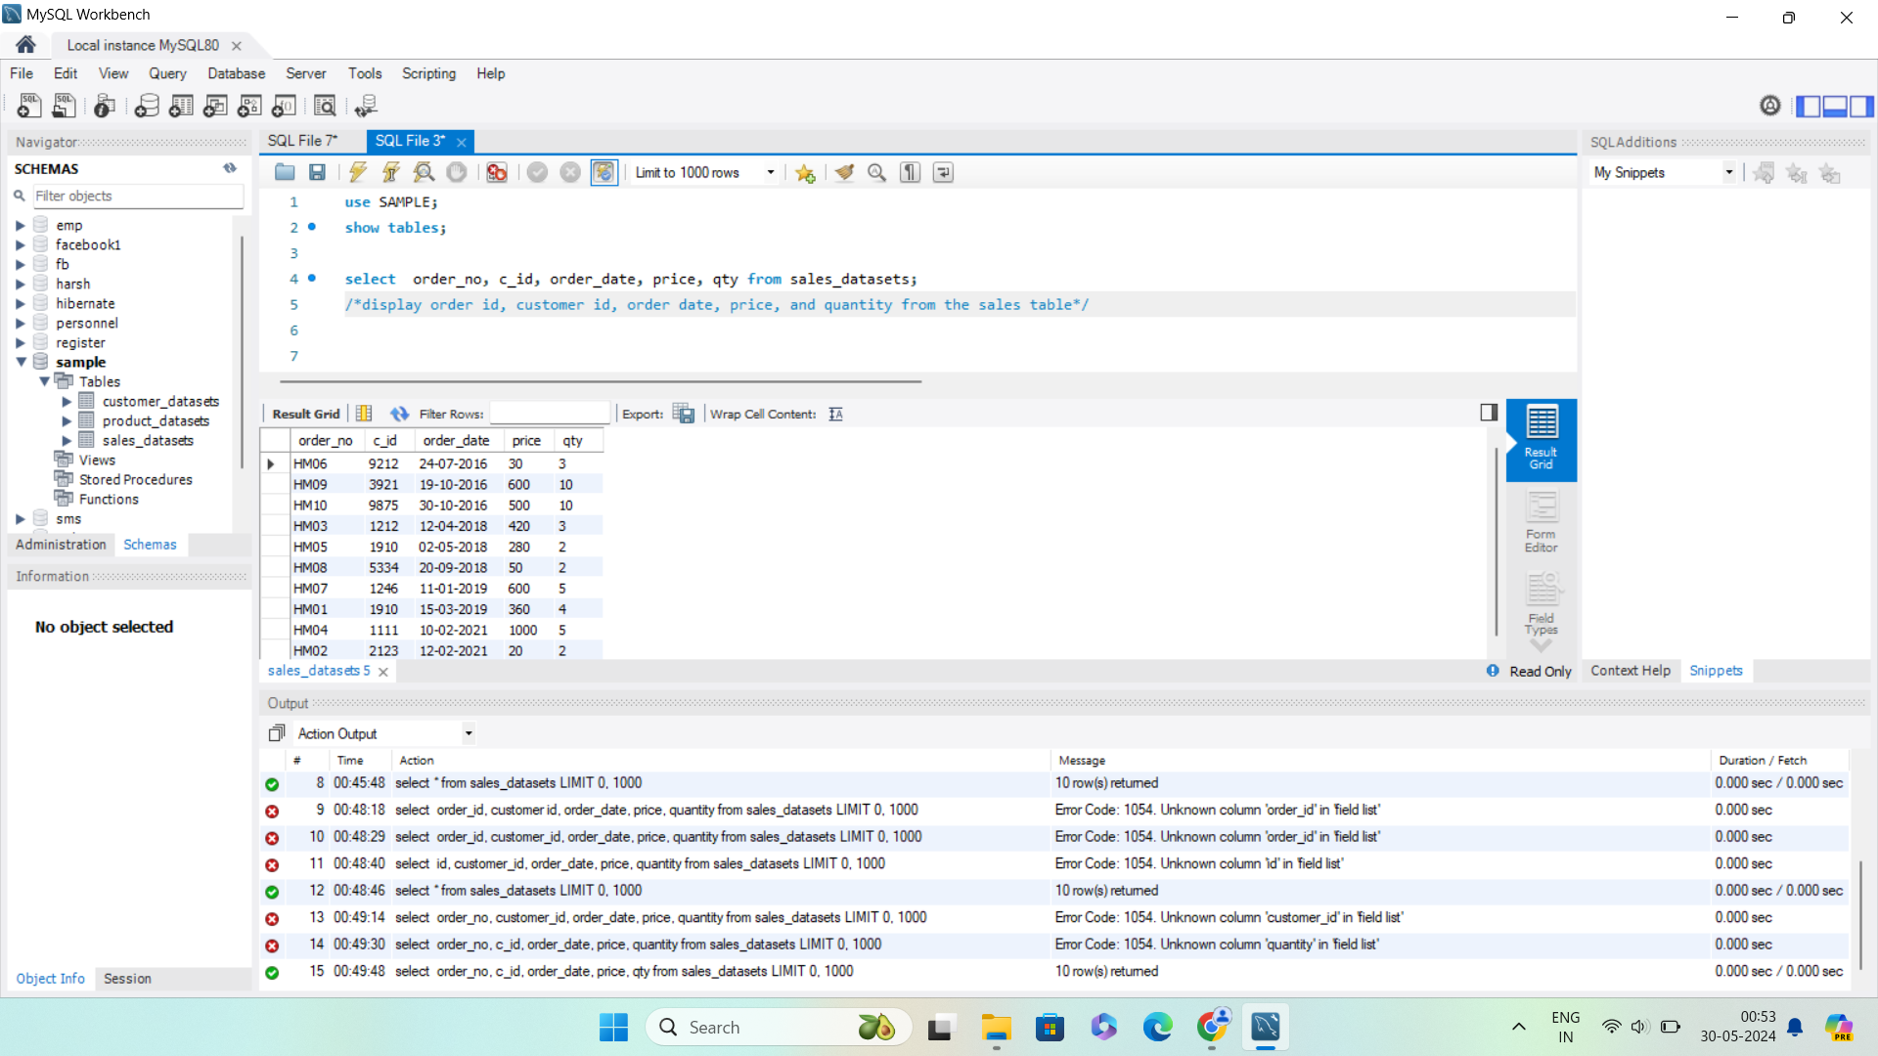
Write a query to display order id, customer id, order date, price, and quantity from the sales table.

Slide 7
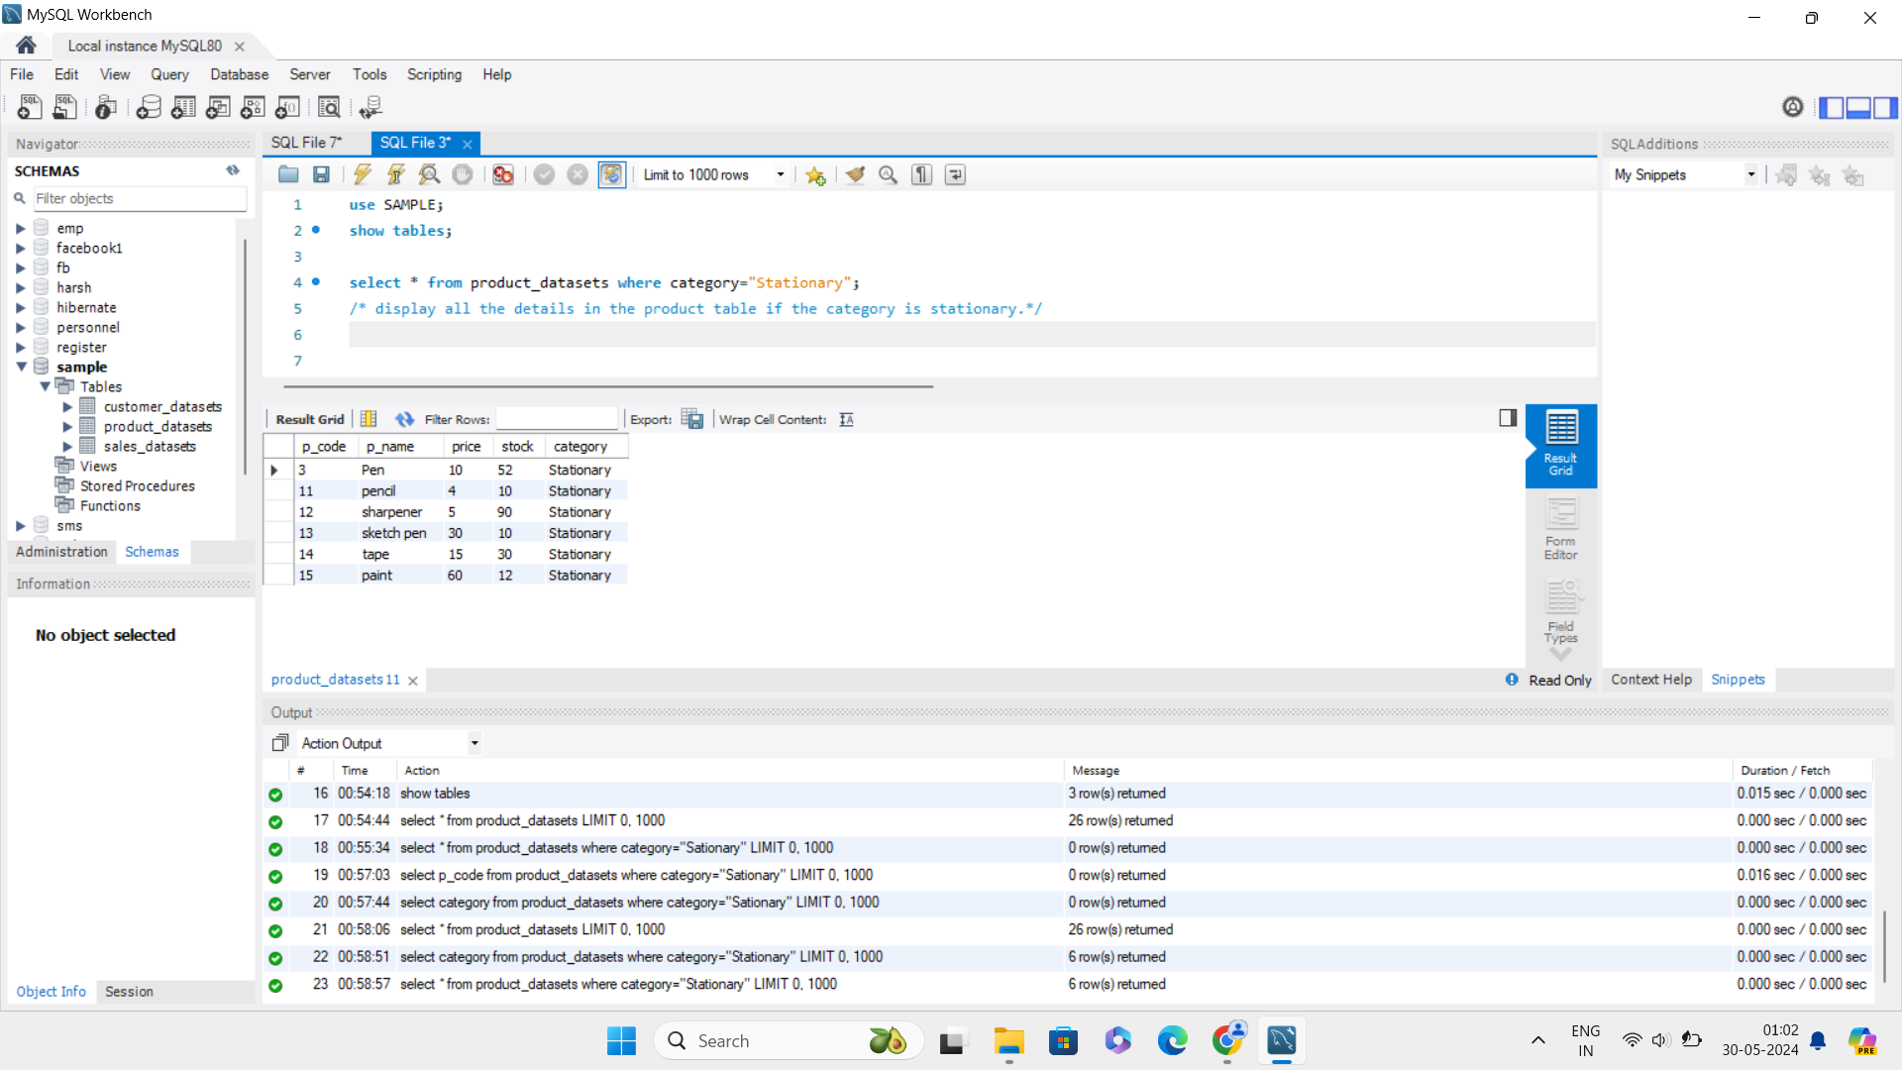
Write a query to display all the details in the product table if the category is stationary.

Slide 8
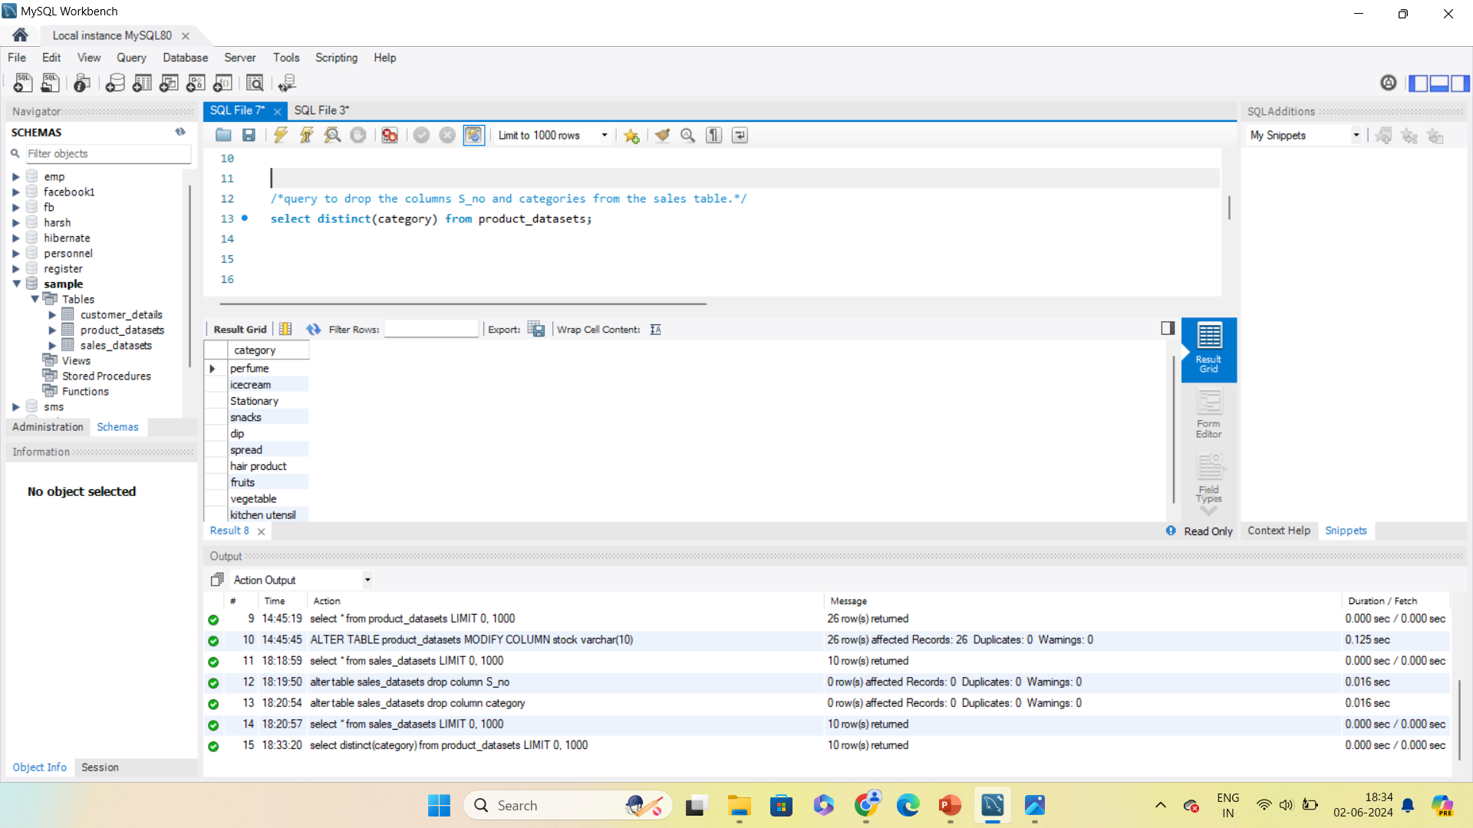
Write a query to display a unique category from the product table.

Slide 9
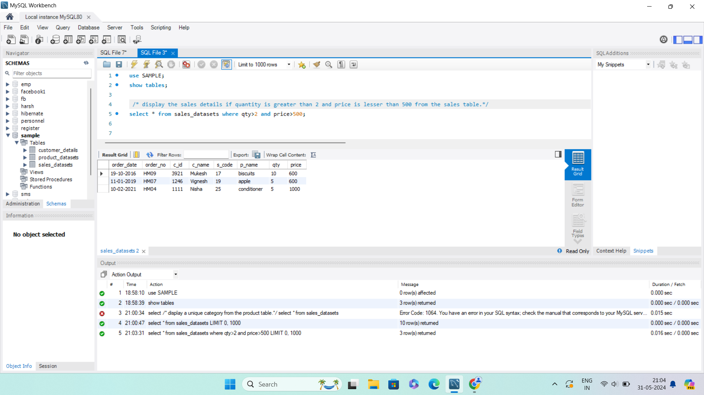
Write a query to display the sales details if quantity is greater than 2 and price is lesser than 500 from the sales table.

Slide 10
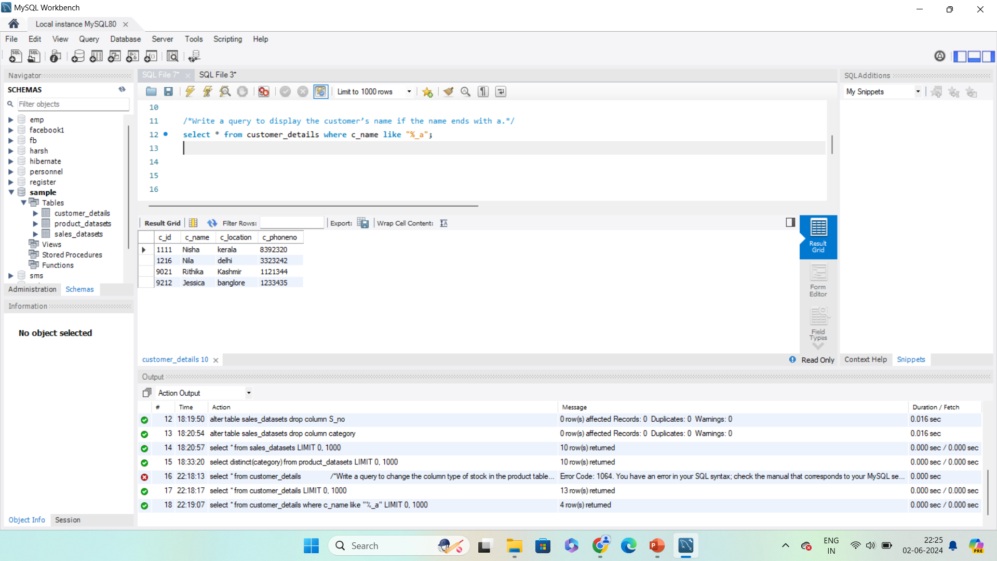
Write a query to display the customer’s name if the name ends with a.

Slide 11
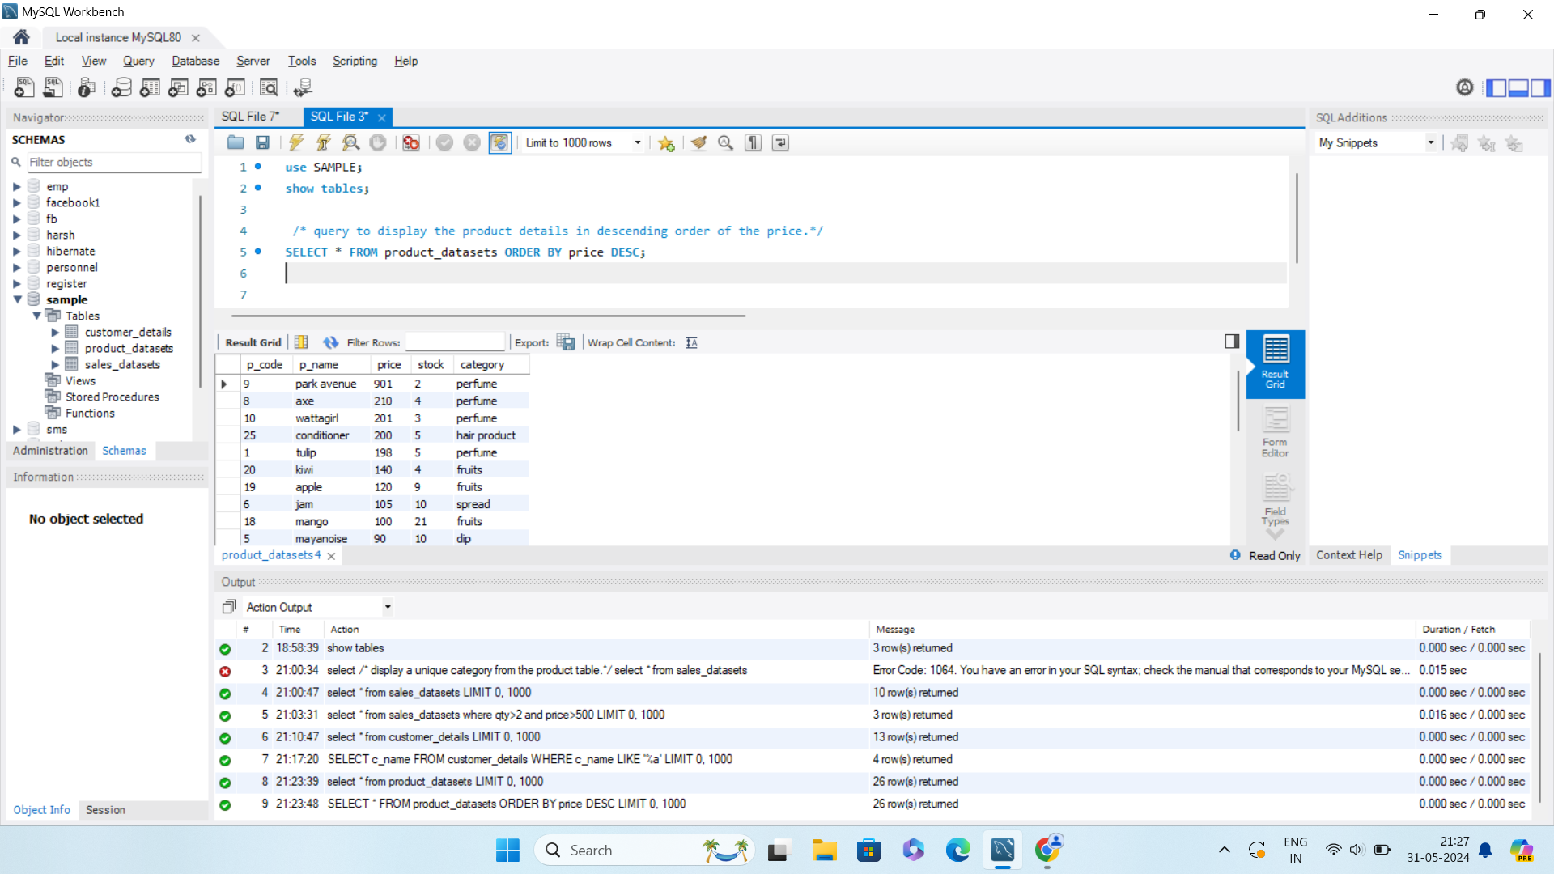
Write a query to display the product details in descending order of the price.

Slide 12
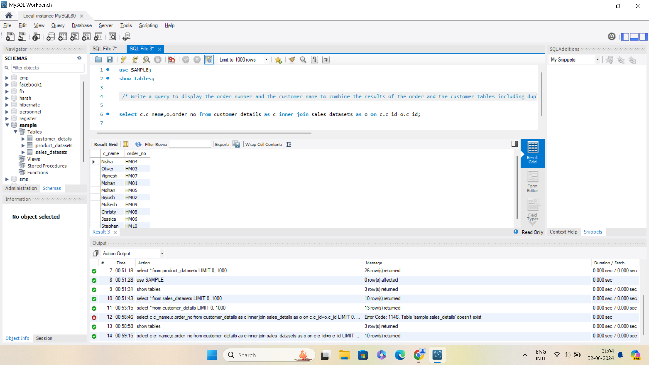
Write a query to display the order number and the customer name to combine the results of the order and the customer tables including duplicate rows.

